Slide 1
Plastic pollution problem in the Atlantic ocean
Almas Saduakas
MD Data Science
Data Visualization

Slide 2
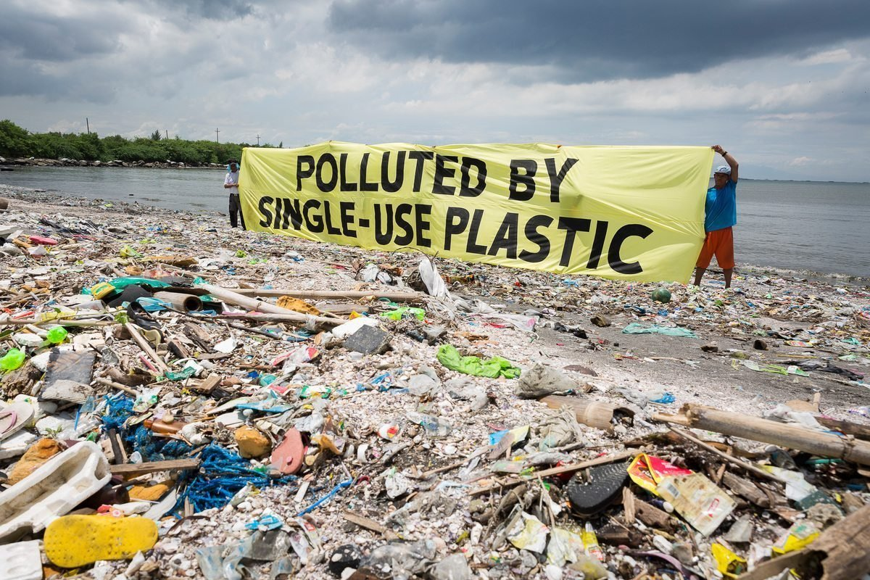
Plastic polution amassing within the environment of manufactured plastic items to the point where they make issues for natural life and their territories as well as for human populaces.

Slide 3
By the conclusion of the 20th century, in any case, plastics had been found to be tireless polluters of numerous natural specialties, from Mount Everest to the foot of the ocean.

Slide 4
The issue of plastics
Plastic may be a polymeric material—that may, be a fabric whose particles are exceptionally expansive, regularly taking after long chains made up of a apparently perpetual arrangement of interconnected joins. Characteristic polymers such as elastic and silk exist in abundance, but nature’s “plastics” have not been ensnared in natural contamination, since they don't endure within the environment.

Slide 5
Nowadays, be that as it may, the normal buyer comes into day by day contact with all sorts of plastic materials that have been created particularly to vanquish normal rot processes—materials inferred primarily from petroleum that can be molded, cast, spun, or connected as a coating.

Slide 6
Each year, more than five million tons of strong squander go to landfills all through the nation. Since the starting of the year, Kazakhs have created 3.2 million tons of metropolitan strong squander. Around 330,000 tons, or 10.5 percent, was reused and arranged, a twofold increment compared to 2016.

Slide 7
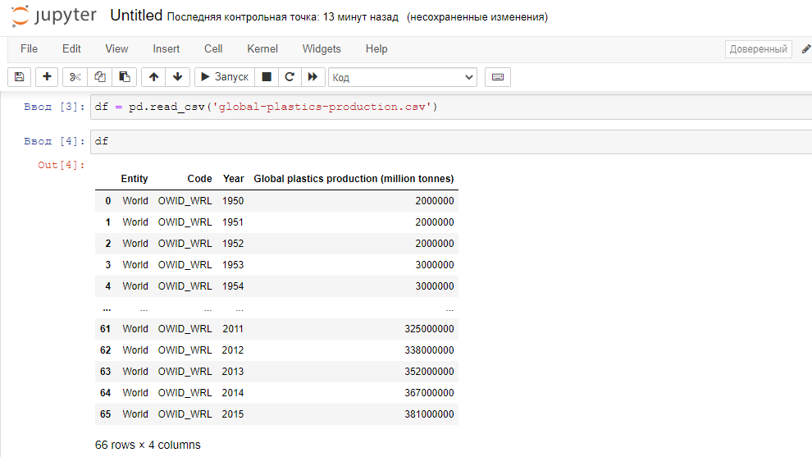
Dataset

Slide 8
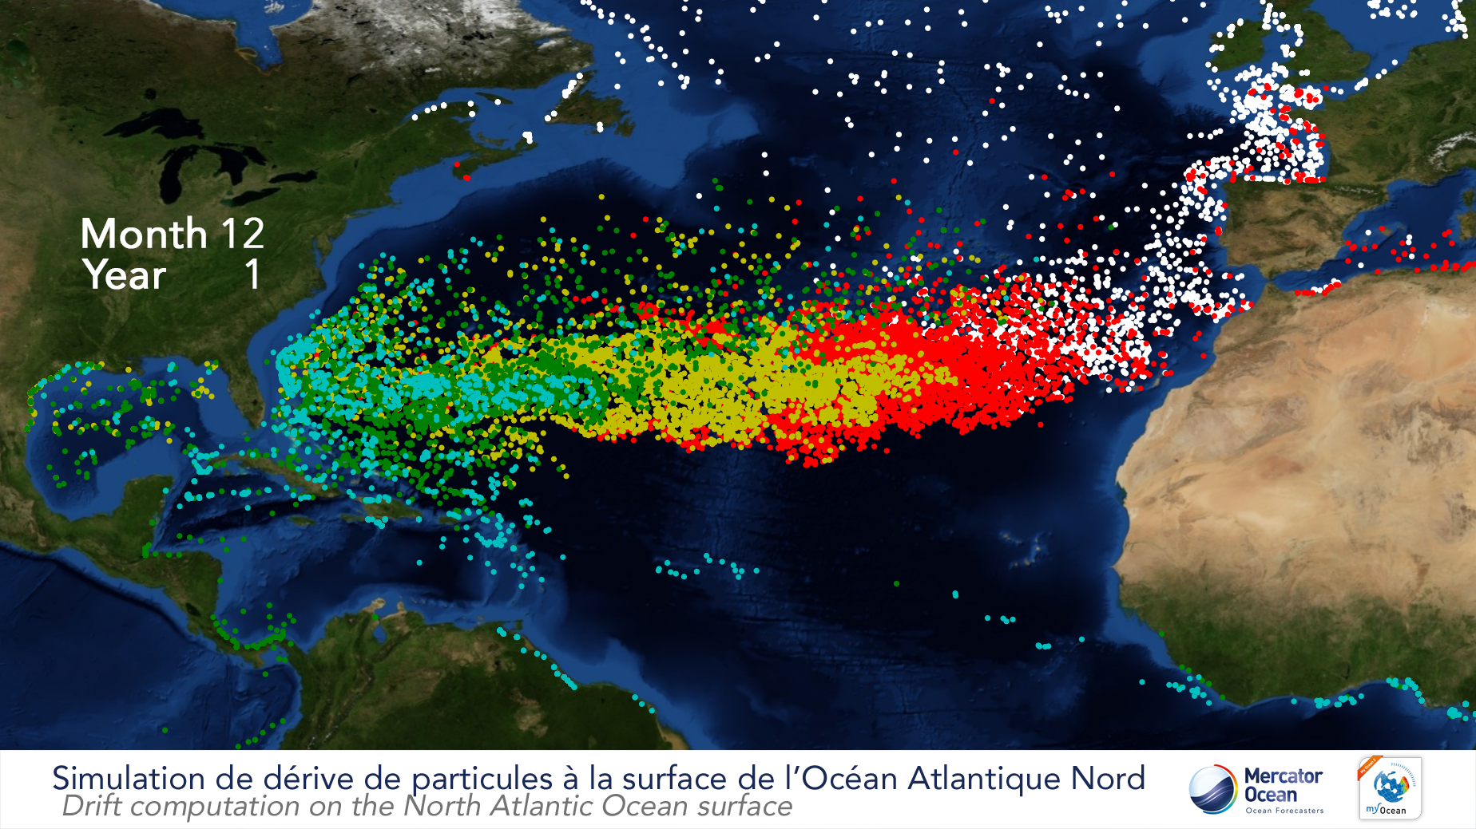

Slide 9
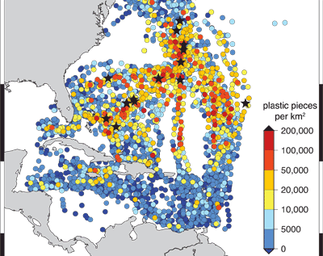
Amount of plastic near the east coast of Usa

Slide 10
To make strides the share of civil strong squander reusing, the service has presented partitioned squander collection and fortified reusing through public-private associations. The administrative system was received to upgrade the country’s squander management.

Slide 11
Plastic pollution in uk
A comparable law will come into impact in 2019 forbidding plastic, paper, cardboard and glass burying. As of October, 2015, stores within the UK started charging five pence per single-use plastic carrier sack. Shoppers can maintain a strategic distance from this charge by bringing a reusable pack to carry their merchandise. The plastic sack charge applies to any trade that has more than 250 employees. Impact: Since the sack tax’s presentation in 2015, authorities assess that plastic sack utilization has been diminished by more than 80%.

